Slide 1
Who is God?
Foundations of Faith
Pastor Dona Schepens

Slide 2
Rational & Empirical Evidence show
God exists
God has revealed himself to us.

Slide 3
Definition
The one God of Christianity is an active being that is defined by his works and his attributes and is foremost revealed to us through Scripture. In Christianity, God is one God, coexisting in three “persons” called the Trinity…the Father, the Son, and the Holy Spirit.

Slide 4
Who is God?
3 areas that point us to God:
Creation
The Bible
History
Through revelation God speaks for Himself

Slide 5
God of Creation
In the beginning, God (Gen 1:1)
Created heavens, earth, seas, land
God saw it was good
Created humans in God’s image (Gen 1:27)

Slide 6
Creation reveals God
Psalm 19 – heavens declare the glory of God
General Revelation
God’s existence and power seen
Romans 1:20 – power and divine nature

Slide 7
God of the Bible
Reveals nature (attributes), character, and work of God
Special Revelation – God manifests Himself

Slide 8
“The objective of special revelation was relationship. The primary purpose of this revelation was not to enlarge the general scope of knowledge. The knowledge about was for the purpose of knowledge of.” (Christian Theology by Millard J. Erickson)

Slide 9
God is revealed … Names
Names of God
Over 100 names in Scripture
I AM (Exodus 3:14)
Trust in the name of the Lord (Ps 20:7)

Slide 10
Jehovah…
Jireh -- The Lord will provide (Gen 22:14)
Rapha -- The Lord who heals (Exodus 15)
Nissi -- The Lord my banner (Exodus 17:15)
Shalom -- The Lord is peace (Judges 6:14)
Shammah -- The Lord is there (Ez. 48:35)
Culminates NT -- Name of Jesus (Phil 2:5-11)

Slide 11
God is revealed…Attributes
God is:
Light, in him there is no darkness (1 John 1:5),
love (1 John 4:8),
one (Deut 6:4),
perfect (Matt 5:48),
Holy (Lev 19:2, Is 43:3),
all powerful (Josh 4:23-24)

Slide 12
God is revealed…Attributes
God is:
the Rock, perfect and just, God is faithful (Deut 32:3-4, I Cor 1:9)
not limited by space or time, God exists everywhere (Acts 17:24-25, Psalm 139:7-12)
all knowing (Ps 147:5, Is 40:28)
unchangeable (Ps. 102:26-27, Mal 3:6, James 1:17)

Slide 13
God is revealed…character
God is:
just (Acts 17:31)
loving (Ephesians 2:4-5)
truthful (John 14:6)
holy (1 John 1:5)

Slide 14
God is revealed…character
God is: (cont)
compassionate (2 Corinthians 1:3)
merciful (Romans 9:15)
Full of grace (Romans 5:17)
forgiving (Psalm 130:4)

Slide 15
Godhead = Trinity
Father, Son, and Holy Spirit (Matt. 28:19, Matt 3:16-17
Jesus was fully God – (Colossians 1:1, 2:9, Hebrews 1:3)
Jesus was also fully human (Hebrews 2:14-15)

Slide 16
Jesus
Jesus showed us that God is love (1 John 4:8). It was in love that God sent His Son into the world (John 3:16). It was in love that Jesus died on the cross for sinners (Romans 5:8). It is in love that He still calls sinners to repentance to experience the grace of God and to be called the children of God (1 John 3:1).

Slide 17
Holy Spirit
The Spirit is:
fully God
sent from the Father and the Son to live within believers to guide, teach, and empower
convicts the world of its guilt regarding sin

Slide 19
“Trade in a little of your absolute certainty for divine mystery.”

Slide 20
God of History
Israel – God of the OT and NT

Slide 22
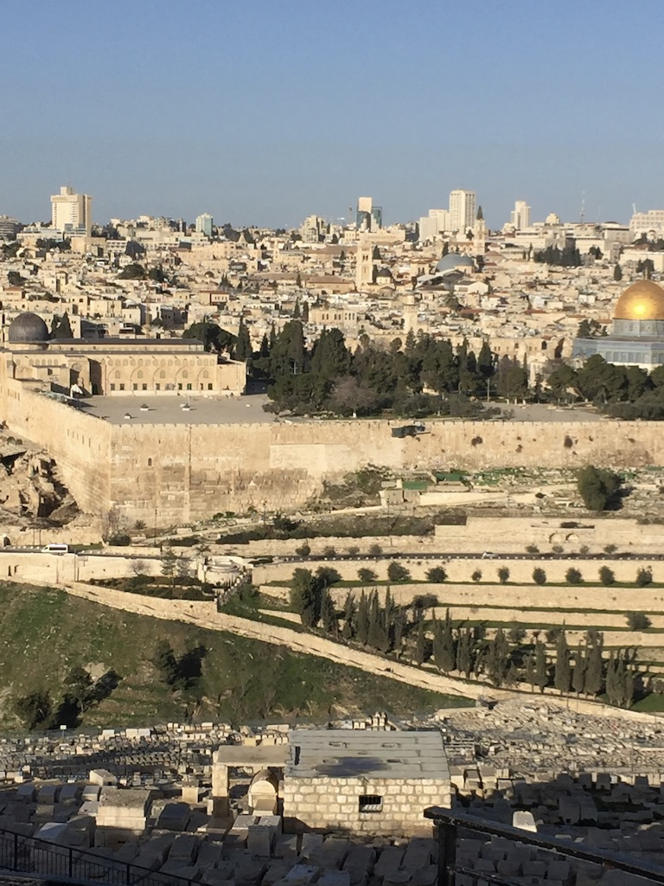

Slide 23
