Slide 1
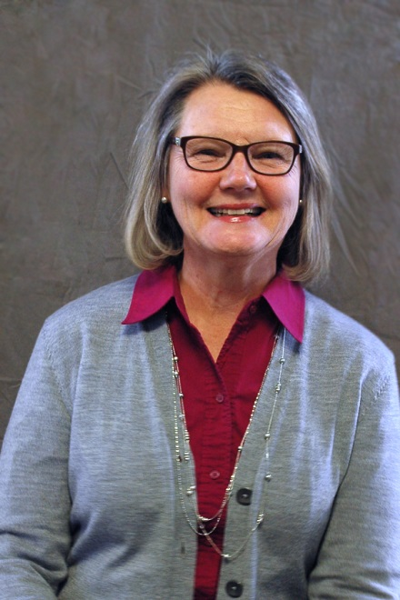
Consecration
of
Dona
Schepens

Slide 2
Words of Encouragement
2 Timothy 4:1-8 Page 965

Slide 3
Words of Encouragement
2 Timothy 4:1-8 Page 965
“In the presence of God and of Christ Jesus, who will judge the living and the dead, and in view of his appearing and his kingdom, I give you this charge:”

Slide 4
Words of Encouragement
2 Timothy 4:2-4
“Preach the word”
In season and out of season
Correct, Rebuke
Encourage – great patience
Disregard sound doctrine –itching ears want to hear - myths

Slide 5
Priscilla

Slide 6
Words of Encouragement
2 Timothy 4:5
“Keep your head in all situations”
Don’t get distracted
“Our battle is not against flesh and blood, but against…spiritual forces.” Eph. 6:12

Slide 8
Words of Encouragement
2 Timothy 4:5
“Endure hardship”
“Your battle is not against flesh and blood
Life is hard, but you got this
Stick close to the Father!

Slide 10
Words of Encouragement
2 Timothy 4:5
“Do the work of an evangelist”
Look for opportunities
Live it

Slide 11
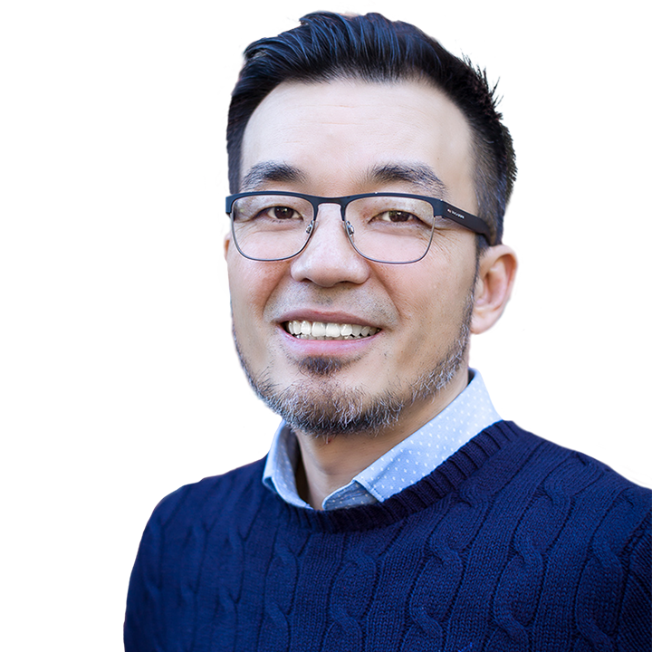

Slide 12
“What is significant in the eyes of God is often seen as insignificant in the eyes of the world.” – Ted Kang

Slide 13
Words of Encouragement
2 Timothy 4:5
“discharge all the duties of your ministry”
You shouldn’t & can’t do it all
Share all the good stuff

Slide 15
Response
“I have fought the good fight, I have finished the race, I have kept the faith.” v.7
“Now there is in store for me the crown of righteousness--all who have longed for his appearing.” v.8

