Slide 3
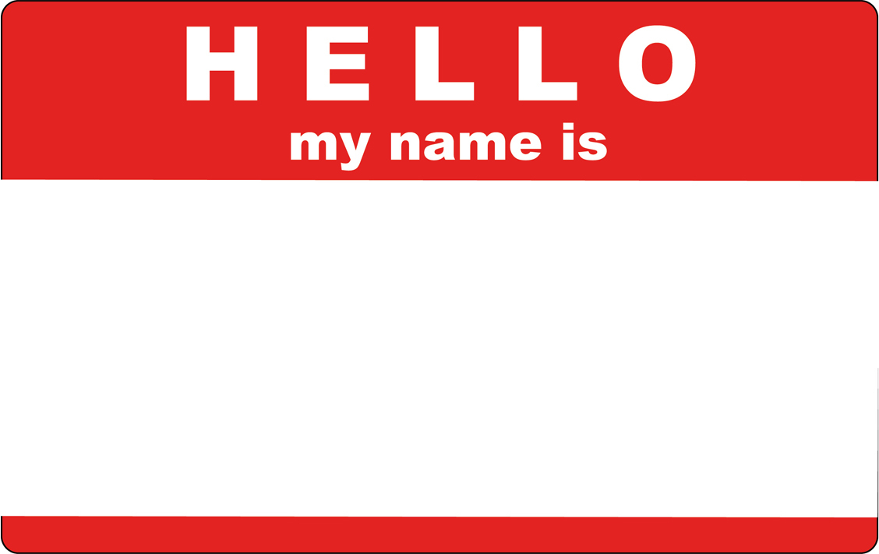

Slide 4
Hello My Name Is…
Acts 22 & 23 Page 904
Paul is in Jerusalem
Some Jewish people see him at the temple and stir up the people against him
They lied and said he was leading people away from the Law and had brought a Gentile into the Temple

Slide 5
Hello My Name Is…
Acts 22 & 23 Page 904
So mad, they were literally trying to kill him
Commander of the Roman troops steps in and they are making all kinds of accusations against Paul.

Slide 6
Hello My Name Is
Acts 22:1-24 Page 904

Slide 7
Hello My Name Is
Act 22:1-24
Paul shares his whole story of conversion
He talks about being present and affirming the killing of Stephen
He does this to show affinity.

Slide 8
Hello My Name Is
Act 22:1-24
But then he told them how God sent him to the Gentiles
“The crowd listened to Paul until he said this.” v.22
The “this” - Gentiles

Slide 9
Hello My Name Is
Act 22:1-24
The fact that Paul believed that God was offering access to Gentiles led the crowd to want to “rid the earth of him!”

Slide 10
Hello My Name Is
Act 22:1-24
“You may come to God just as you are – Jew, Gentile, foreigner, high, low, rich, or poor – but you must come to Him through Jesus Christ.”
Guzik

Slide 11
New

Slide 12
Hello My Name Is
Act 23:1-11

Slide 13
Hello My Name Is
Act 23:1-11
The commander stepped in an kept them from killing Paul
But wanted to Know more so he brought Paul before the Sanhedrin.

Slide 14
Hello My Name Is
Act 23:1-11
“I have fulfilled my duty to God in all good conscience to this day.”
At this Ananias orders Paul to be hit on the mouth.
Paul “You whitewashed wall!”

Slide 15
Hello My Name Is
Act 23:1-11
The appearance of good, purity but really evil and corrupt
This is both accurate and justified
But Ananias is the High Priest and Paul retracks his words

Slide 16
Hello My Name Is
Act 23:1-11
He redirects the conversation on Resurrection and Angels – Pharisees believe but the Sadducees do not.
But they are still ready to tear him to pieces.

Slide 17
Hello My Name Is
Act 23:1-11
God spoke to him – “Take courage! As you have testified about me in Jerusalem, so you must also testify in Rome.” v.11

Slide 18
New

Slide 19
Hello My Name Is
Act 23:12-15
40 men vow to fast until they have killed Paul
This is found out and the Roman Commander protects him – “Take Courage”

Slide 20
New

Slide 21
Response
What words or phrases (lies) have been spoken over you-that have landed like a name?
Take the name tag provided and write the opposite (or how God sees you) in the space provided for your name.

