Slide 1


Slide 3
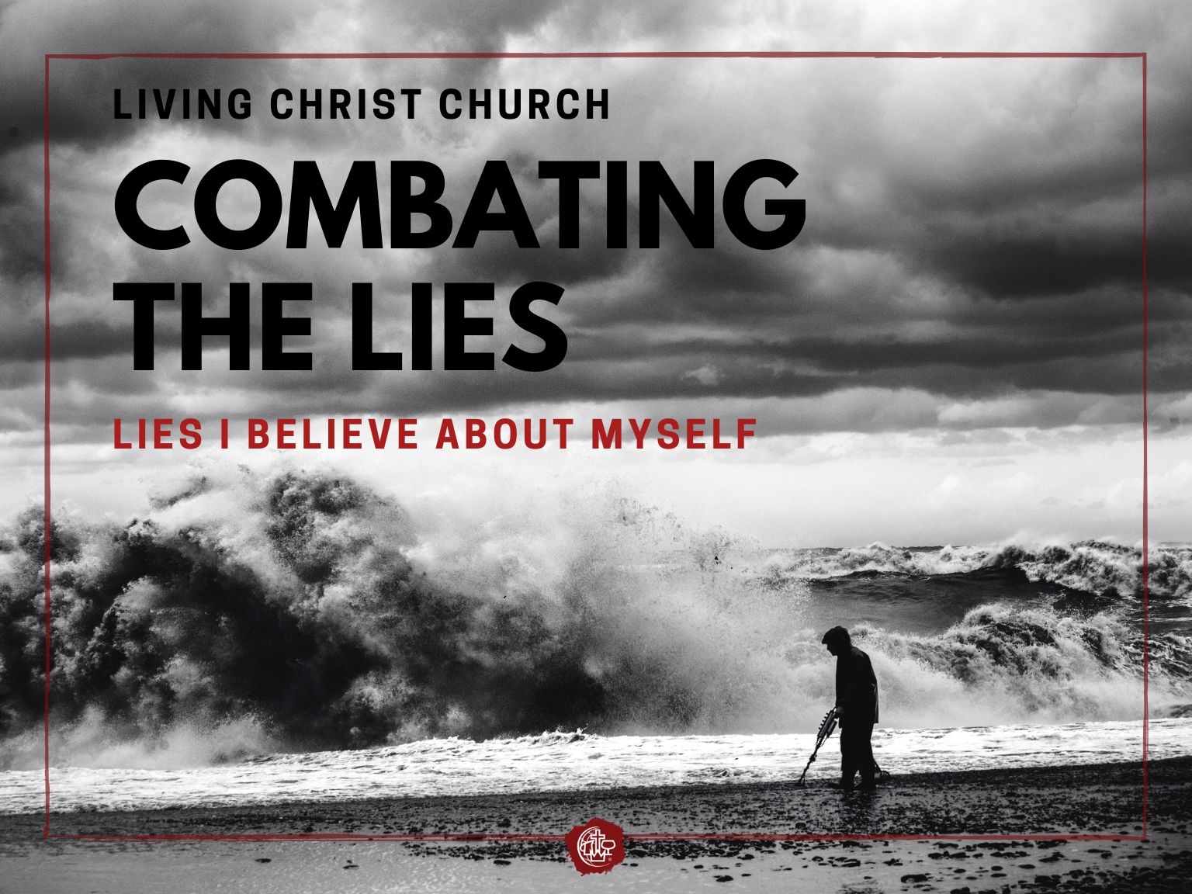

Slide 4
The Lies I Believe About Myself
  Luke 15 Page 849
  This story is called a parable
  A parable is a simple story to illustrate a spiritual truth
  This story follows two other stories about lost things

Slide 5
The Lies I Believe About Myself
  Luke 15 Page 849
  The parable of the lost son
  The parodical son
  The loving father

Slide 6
The Lies I Believe About Myself
  Luke 15:11-16 Page 849

Slide 7
The Lies I Believe About Myself
  Luke 15:11-16
  “I can do this myself—I don’t need anyone.”
  Although it’s unusual during this time you could get your inheritance before your father passed.

Slide 8
The Lies I Believe About Myself
  Luke 15:11-16
  In this story the father represents God; he lovingly lets the son have his request
  His love allows for our rebellion, our human will

Slide 9
The Lies I Believe About Myself
  Luke 15:11-16
  “Set off for a distant country.” – get as far away as possible—I got this.
  Squandered it all – to throw it in the air

Slide 10
The Lies I Believe About Myself
  Luke 15:11-16
  “on wild living” – extravagant, excessive, reckless, wasteful – he did not hinder himself from anything he wanted.

Slide 11
The Lies I Believe About Myself
  Luke 15:11-16
  He lost everything he had.
  Ends up working for a pig farm longing to eat what the pigs eat.

Slide 13
The Lies I Believe About Myself
  Luke 15:17-24

Slide 14
The Lies I Believe About Myself
  Luke 15:17-24
  “I am not good enough—I have little to no value.”
  Mentally formulates his repentance.
  “No longer worth to be called your son.” v.19

Slide 15
The Lies I Believe About Myself
  Luke 15:17-24
  He thinks his best case scenario is to become one of his fathers servants.
  A slave considered part of the family but a servant could be dismissed at a moments notice.

Slide 16
The Lies I Believe About Myself
  Luke 15:17-24
  When he comes home his father runs to him when he’s still a long ways off – hugs and kisses.
  He throws a huge party

Slide 17
The Lies I Believe About Myself
  Luke 15:17-24
  The God of the universe is waiting for us to come to our senses so that he can say, “Welcome home son/daughter, I love you.”

Slide 19
The Lies I Believe About Myself
  Luke 15:25-32

Slide 20
The Lies I Believe About Myself
  Luke 15:25-32
  “What I do (my works), defines who I am.”
  The other brother is mad that his dad threw a party – It’s not fair.

Slide 21
The Lies I Believe About Myself
  Luke 15:25-32
  He’s so angry he refuse to go to the party.
  “I’ve been slaving for you.” v.29
  You never once threw a party for me!

Slide 22
The Lies I Believe About Myself
  Luke 15:25-32
  Look at my brother—he’s horrible and has done horrible things—I’m so much better than him.
  “You are always with me, everything I have is yours.” v.31

Slide 23
The Lies I Believe About Myself
  Luke 15:25-32
  Your brother was lost and is found—God is about the whole family, the whole community.

Slide 24
The Lies I Believe About Myself
  Luke 15:25-32
  The world, mostly judges by what we do and don’t do, God cares about what is done for you—Your value is found in Him.

Slide 26
Response
  Where in your life do you need to let others and God in?
  What part of you needs to receive the Love of God—Hear your value is in Him?
  What are you trying to prove (to God)?

