Slide 1
The Lifestyle of Thankfulness

Slide 6
In Jesus - Blessed is not what you have, it’s who you are

Slide 8
Blessed
Ephesians 1 Page 947

Slide 9
Blessed
Ephesians 1:1-14
“Praise be to the God and Father of our Lord Jesus Christ, who has blessed us in the heavenly realms with every spiritual blessing in Christ.” v. 3

Slide 10
Blessed
Ephesians 1:1-14
Blessed: Consecrated, bestowed upon..
Spiritual Blessing: invocation of blessing, benediction.
You have been declared BLESSED!

Slide 11
Blessed
Ephesians 1:1-14
Chosen (before creation)

Slide 12
Blessed
Ephesians 1:1-14
Chosen (before creation)
In Love, Adopted (His Will)

Slide 13
Blessed
Ephesians 1:1-14
Chosen (before creation)
In Love, Adopted (His Will)
Grace (freely given)

Slide 14
Blessed
Ephesians 1:1-14
Chosen (before creation)
In Love, Adopted (His Will)
Grace (freely given)
Redemption (forgiven)

Slide 15
Blessed
Ephesians 1:1-14
Chosen (before creation)
In Love, Adopted (His Will)
Grace (freely given)
Redemption (forgiven)
Wisdom & Understanding – The Mystery - Jesus

Slide 16
Blessed
Ephesians 1:1-14
Wisdom & Understanding – The Mystery - Jesus
Sealed with the Holy Spirit

Slide 17
Blessed
Ephesians 1:1-14
Wisdom & Understanding – The Mystery - Jesus
Sealed with the Holy Spirit
An inheritance (Heaven)

Slide 19
He is Beholding You

Slide 20
Blessed
Ephesians 1:14-23

Slide 21
Blessed
Ephesians 1:15-23
Paul is excited about those in Ephesus who have put their hope and trust in Jesus

Slide 22
Blessed
Ephesians 1:15-23
Paul is excited about those in Ephesus who have put their hope and trust in Jesus.
His prayer – God would give them wisdom and revelation to know God better.

Slide 23
Blessed
Ephesians 1:15-23
“I pray that the eyes of your heart may be enlightened in order that you may know the hope to which he has called you, the riches of his glorious inheritance in his holy people.” v.18

Slide 24
Blessed
Ephesians 1:15-23
Heart – seat of the spiritual life, the center of thoughts, passions, desires, etc.
That the core of you would understand what it means to be in and have Jesus in your life.

Slide 25
Blessed
Ephesians 1:15-23
“His incomparably great power for us who believe.” v. 19
Raised Christ from the dead

Slide 26
Blessed
Ephesians 1:15-23
“His incomparably great power for us who believe.” v. 19
Raised Christ from the dead
Seated with Him in the Heavenlies

Slide 27
Blessed
Ephesians 1:15-23
“His incomparably great power for us who believe.” v. 19
Raised Christ from the dead
Seated with Him in the Heavenlies
Everything placed under His feet.

Slide 29
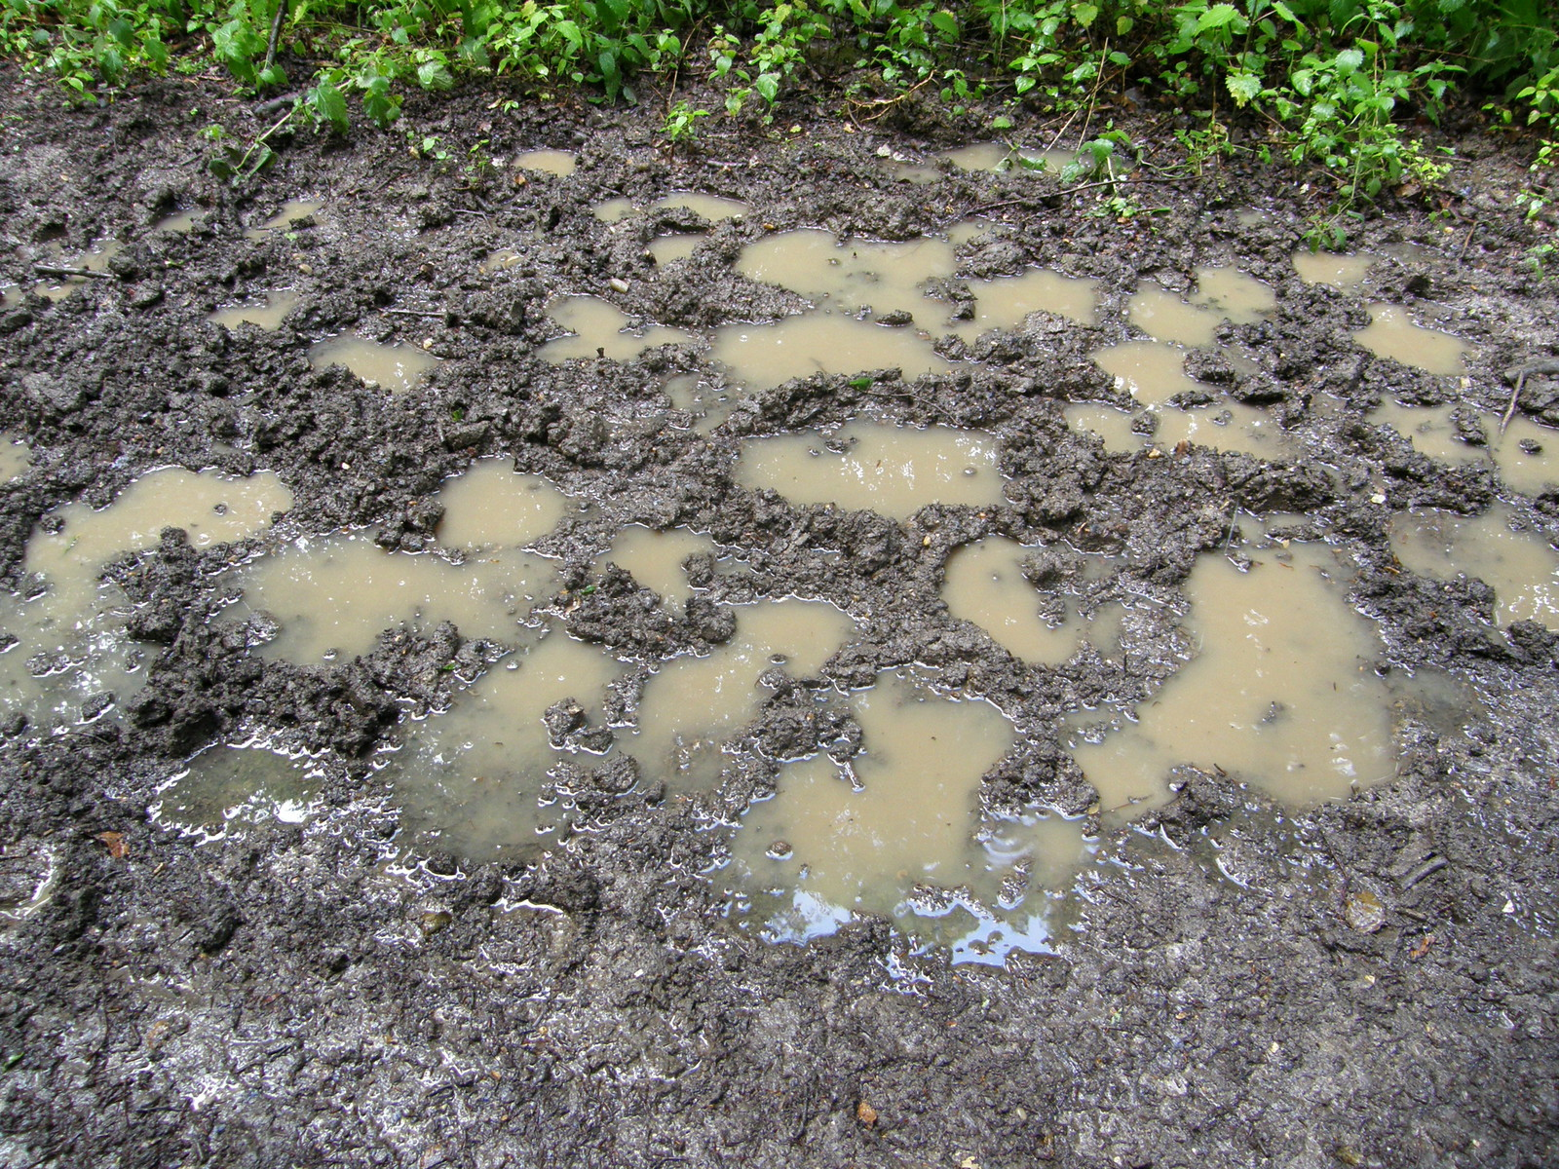

Slide 30
The Holy Spirit is knee deep with you in whatever crap you find yourself in.

Slide 31
#Blessed

Slide 32
Response
You are Blessed

